Slide 1

Medical Cost
Prediction
Prepared by: Maheen Shahid

Slide 2

Introduction
This project focuses on predicting medical expenses based on various factors such as age, BMI, number of children, smoking habits, and region. The goal is to develop a model that can accurately estimate medical costs, providing valuable insights for both individuals and insurers.
.

Slide 3
Factors Influence by Medical Cost:
1. Age:
Determine the correlation between age and medical expenses, considering age-related
health issues and required treatments.
2. Gender:
Explore how gender influences healthcare utilization and costs, focusing on gender-specific health concerns.
3. Health Profile:
Analyze the impact of BMI, smoking habits, and other health indicators on medical expenses.
4. Location:
Investigate the influence of region on medical costs, considering healthcare infrastructure and accessibility

Slide 4
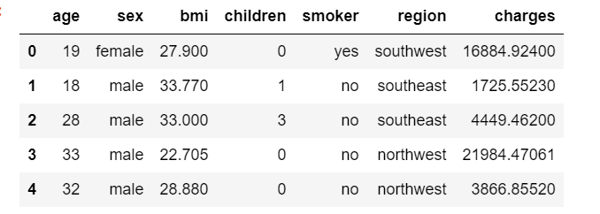
Data set information
Dataset Content
The dataset used in this project is related to insurance and healthcare. It contains information on individuals, including features such as age, gender, BMI, number of children, smoking habits, region, and medical expenses (charges). Utilization of describe(), info() and head() functions to get overview of data

Slide 5
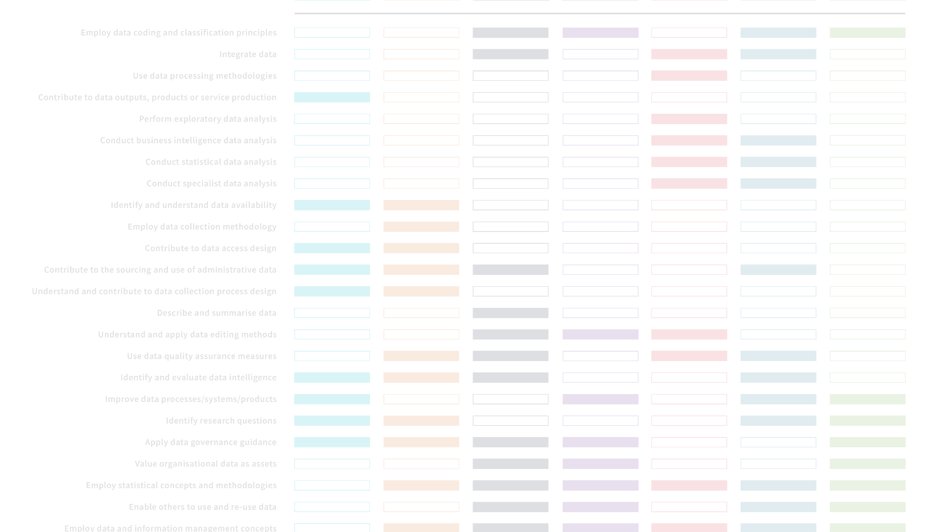
Methodology
1
Exploratory Data Analysis (EDA)
Utilize visualizations (histograms, count plots, box plots, scatter plots) to understand the distribution of age, gender, BMI, children, region, smoking habits, and charges. Analyze the relationships between medical expenses and other features.
2
Data Preprocessing
Convert categorical variables (gender, smoking habits, region) into numerical form. Split the dataset into training and testing sets.
3
Model Building
Implement Linear Regression and Decision Tree Regression models to predict medical expenses. Train the models using the training dataset.

Slide 6
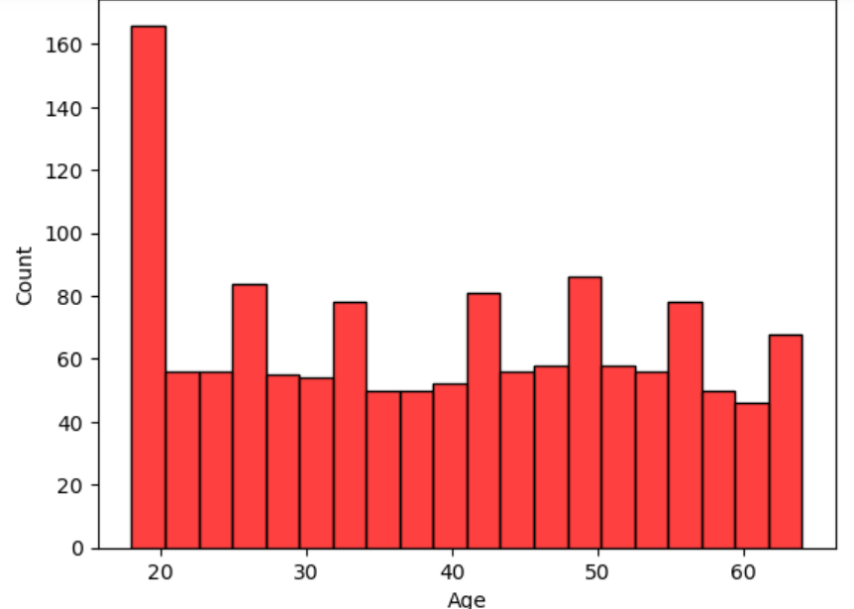
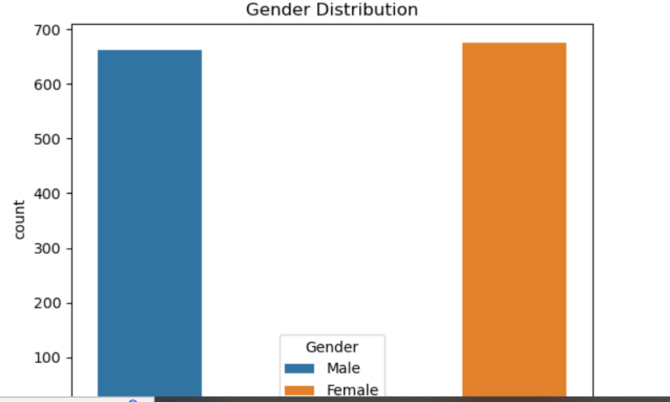
Visualization:
Visualize data using pandas, seaborn and additional libraries to understand the data.
Age Distribution Histogram with Count:
The hisplot function to generate a histogram displaying the age distribution from the age column in the data frame.
Gender Distribution Countplot with Legend:
A countplot illustrating the distribution of genders (Male and Female) in the dataset, with a legend for clarity.“ From the graph we can clearly see that number of males and females are almost equal in the dataset

Slide 7
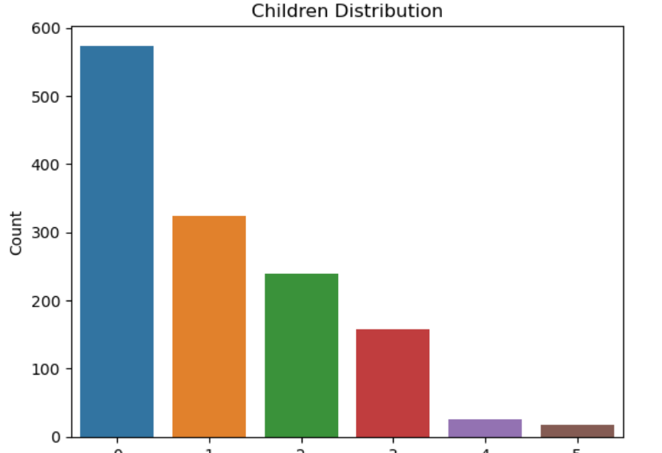
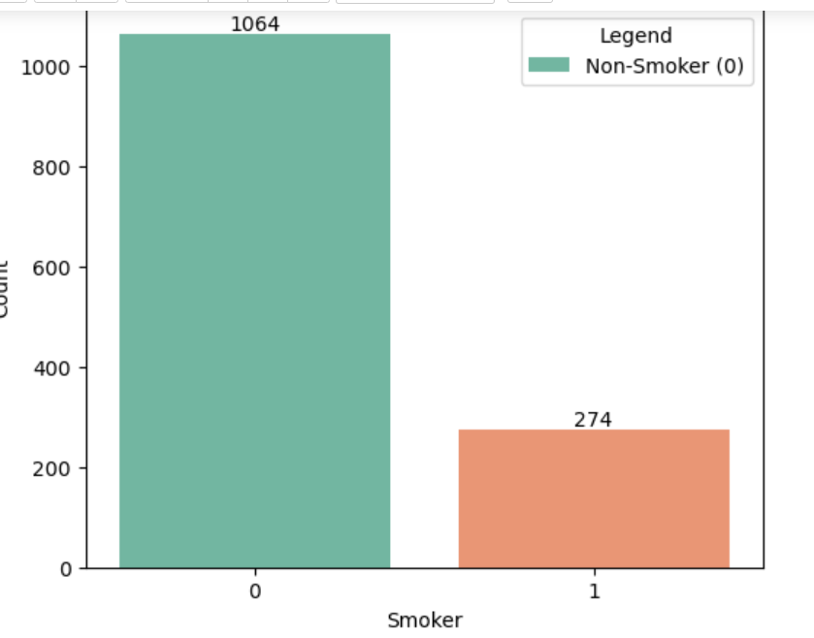
Visualization:
Distribution of Children in the Dataset:
The graph shows how many people in the dataset have different numbers of children. The graph clearly shows that most of the patients have no children and very few patients have more than 3 children.
Count of smoker in the Dataset:
This graph show the count of smokers and non-smokers in the data set. From the graph we can clearly see that smokers are very few in the dataset. Nearly 80% of the patients are non-smokers.

Slide 8
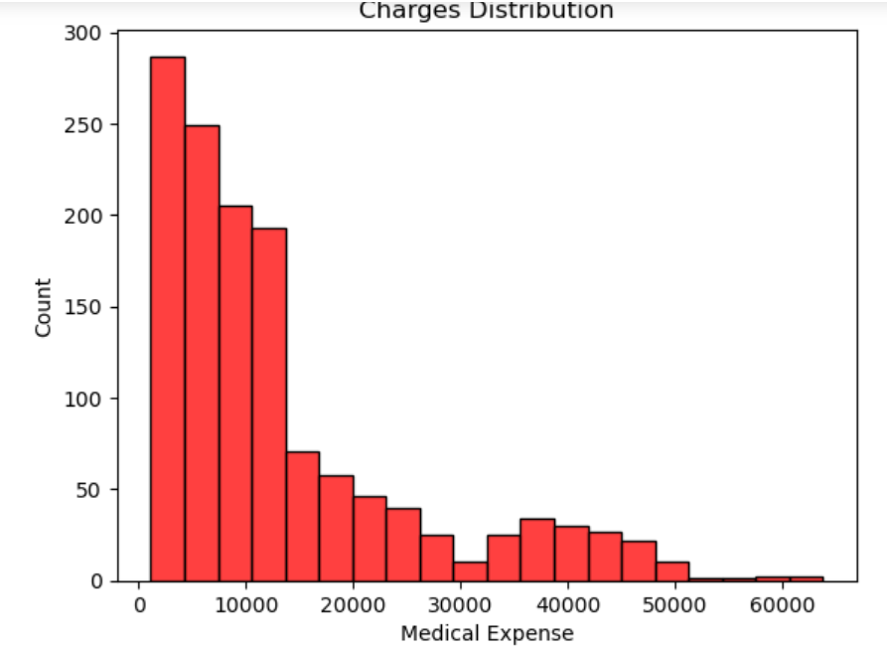
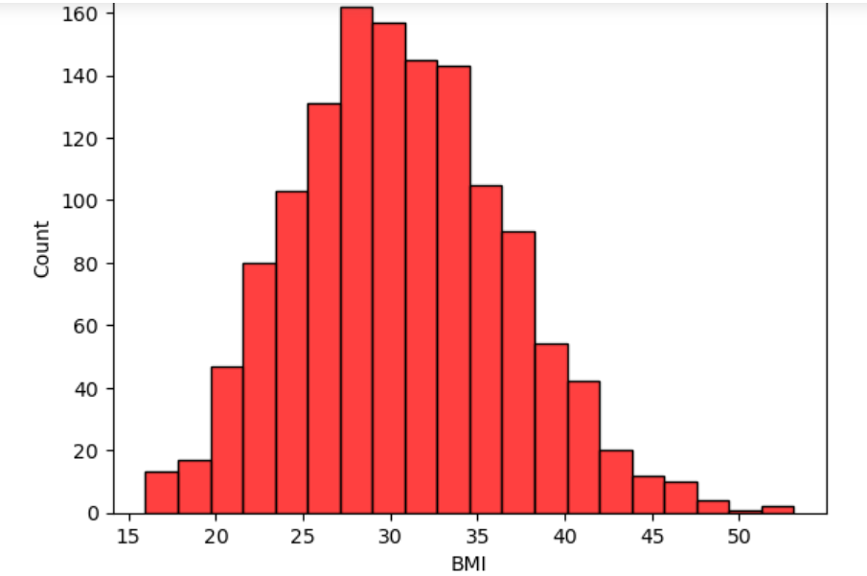
Visualization:
Distribution of Medical Charges:
Here we are plotting a histogram to show how medical charges are distributed in the dataset. As we can see from the graph that most of the medical expenses are below 20000, with negligible number of patients having medical expenses above 50000.
Distribution of BMI in the Dataset:
From the graph we can clearly see that the majority of the patients have BMI between 25 and 40 which is considered as overweight and could be a major factor in increasing the medical cost.

Slide 9
Methodology (continued)
4..
Model Evaluation
Evaluate model accuracy using metrics such as Mean Absolute Error (MAE), Mean Squared Error (MSE), Root Mean Squared Error (RMSE), and R-squared.

Slide 10
Conclusion
In this project we are using two models to predict the medical expense both of our model are giving accurate result but decision tree regressor is giving the best results with the least RMSE value. Therefore we will use decision tree regressor. Moreover, the medical expense of smokers is higher than that of non-smokers. The medical expense of patients with BMI greater than 30 is higher than that of patients with BMI less than 30. The medical expense of older patients is higher than that of younger patients.Thus, from the overall analysis, we can conclude that the medical expense of patients depends on their age BMI, smoking habits.

